Slide 1
GraphQL

Slide 2
Introduction
Why GraphQL.
What is GraphQL.
Who is using GraphQL.
Demo
Schema
Queries
Errors
Mutations
Authentications

Slide 3
Introduction

Slide 4
Why GraphQL?

Slide 5
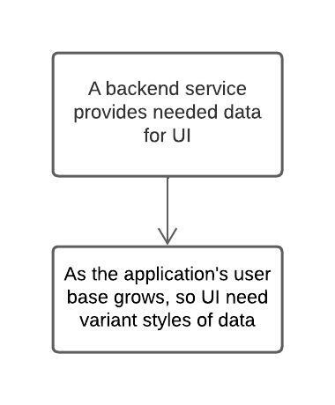
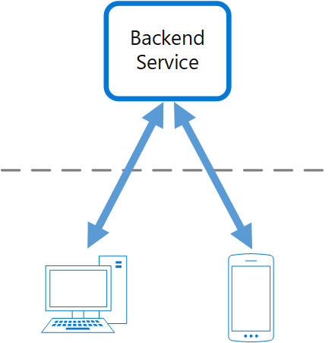
Backend For Frontend (BFF)
Problems
=> Backend becomes bottleneck in development process, spending a lot of effort on a single deployable resource

Slide 6
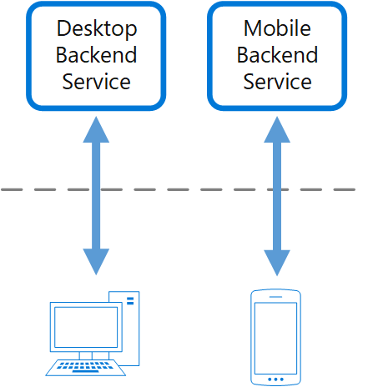
Backend For Frontend (BFF)
Solution
Create once backend per UI.
Fine-tune the behavior and performance of each backend to best match the needs of the frontend environment, without worrying about affecting other frontend experiences.
Each interface team control their own backend.
Give team flexibility to choose language, release candence, tools,...

Slide 7
Backend For Frontend (BFF)
Disadvantage
Duplication features/code acorss services.
Create complexities for backend team.
Responsibilities of a development team.

Slide 8
Backend For Frontend (BFF)
Disadvantage
Duplication features/code acorss services.
Create complexities for backend team.
Responsibilities of a development team.
=> We gonna use microservices here? => Bring all drawbacks of MSA too

Slide 9
Backend For Frontend (BFF)
Disadvantage
Duplication features/code acorss services.
Create complexities for backend team.
Responsibilities of a development team.
=> We gonna use microservices here? => Bring all drawbacks of MSA too.
=> Is there any solutions that can be a single backend for multiple UI?

Slide 10
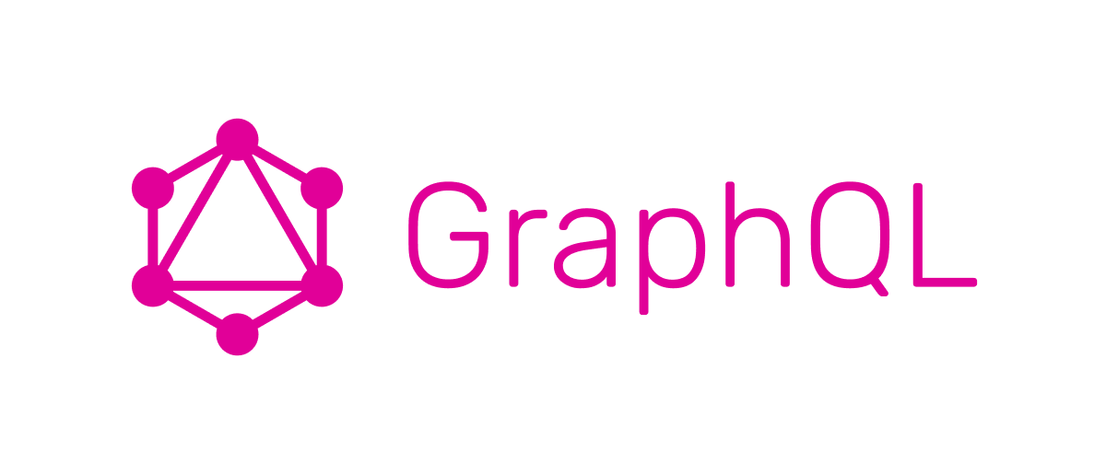
Backend For Frontend (BFF)
Disadvantage
Duplication features/code acorss services.
Create complexities for backend team.
Responsibilities of a development team.
=> We gonna use microservices here? => Bring all drawbacks of MSA too.
=> Is there any solutions that can be a single backend for multiple UI?

Slide 11
What is GraphQL?
Open-sourced by facebook.
A query language for your API.
Ask for what you need, get exactly that.
Get many resources in a single request.
Describe what’s possible with a type system.
Move faster with powerful developer tools.
Evolve your API without versions.
Bring your own data and code.

Slide 12
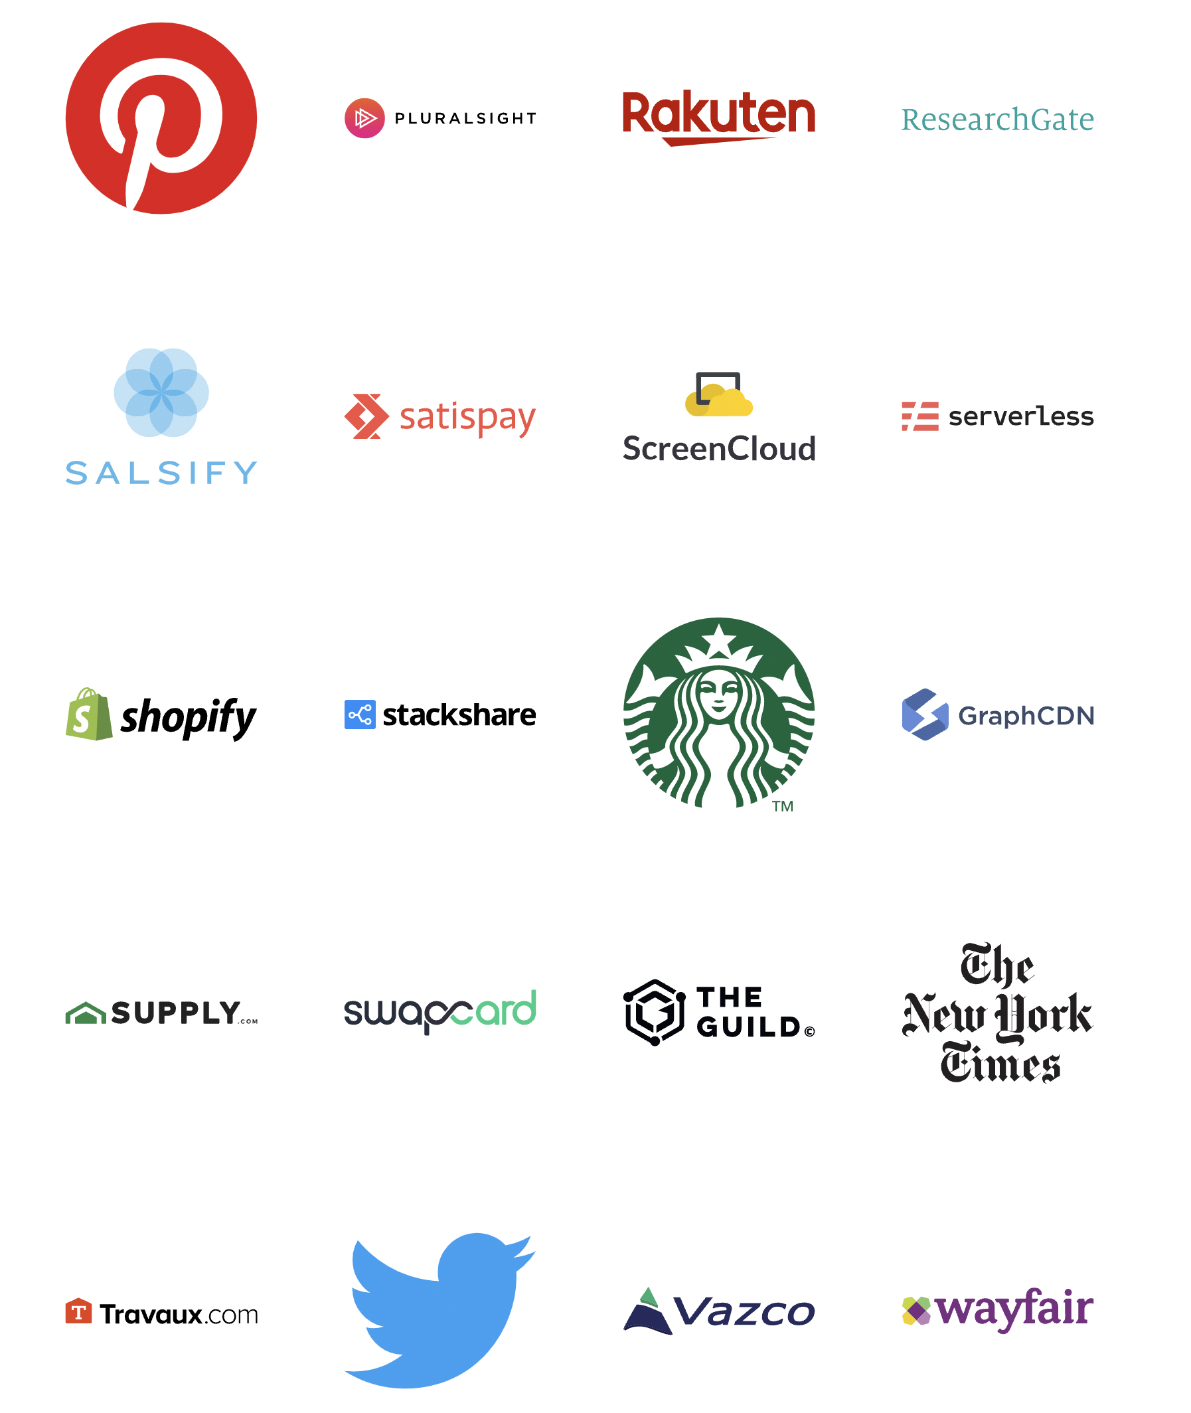
Who is using GraphQL?

Slide 13
01
Schema

Slide 14
What is schema?
A GraphQL schema is a description of the data clients can request from a GraphQL API
Basic Type:
String
Int
ID
Float
Boolean
[Basic Type] => Array with basic type (eg: [String], [Int],...)

Slide 15
What is schema?
A GraphQL schema is a description of the data clients can request from a GraphQL API
Basic Type:
String
Int
ID
Float
Boolean
[Basic Type] => Array with basic type (eg: [String], [Int],...)
Non-null:
Exclamation mark - Type! (eg: String!, Int!,...)

Slide 16
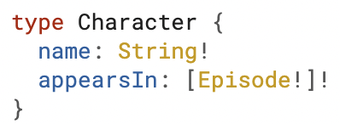
What is schema?
A GraphQL schema is a description of the data clients can request from a GraphQL API
Basic Type:
String
Int
ID
Float
Boolean
[Basic Type] => Array with basic type (eg: [String], [Int],...)
Non-null:
Exclamation mark - Type! (eg: String!, Int!,...)
Character is a GraphQL Object Type
name and appearsIn are fields
name has type string and non-null
appearsIn has type array of Episode and non-null array, also cannot contain null element

Slide 17
02
Queries

Slide 18
What is query?
A query is used to read/fetch data

Slide 19
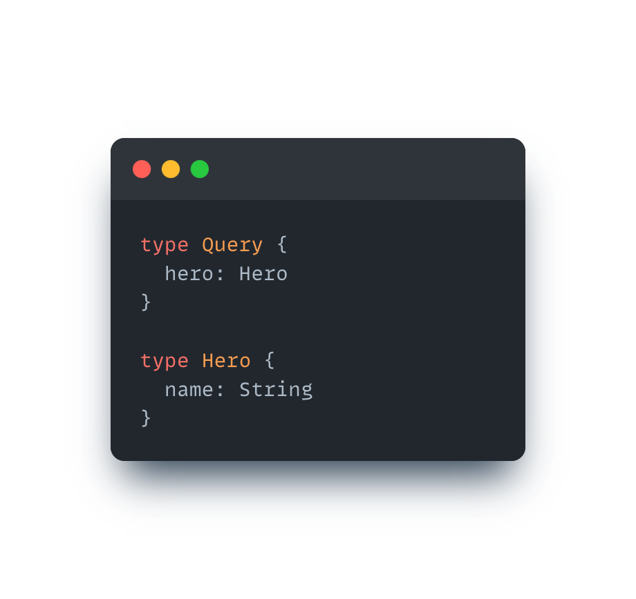
What is query?
A query is used to read/fetch data
How to declare a query?

Slide 20
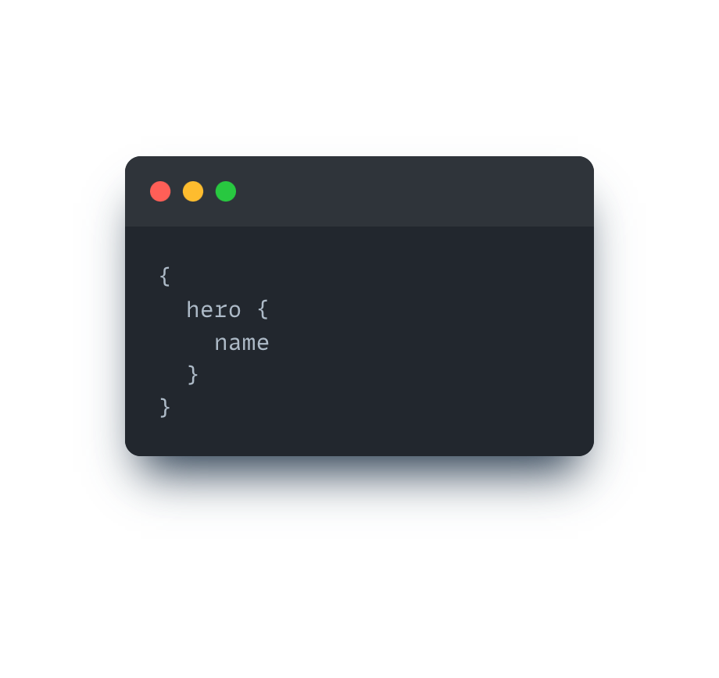
What is query?
A query is used to read/fetch data
How to declare a query?
How to use a query?

Slide 21
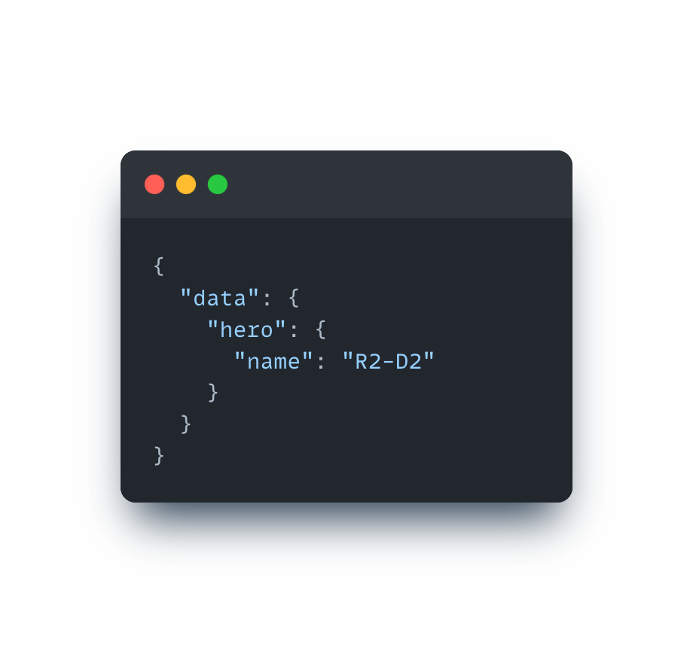
What is query?
A query is used to read/fetch data
How to declare a query?
How to use a query?
Example resposne

Slide 22
What is resolver?
A resolver is used to resolve query

Slide 23
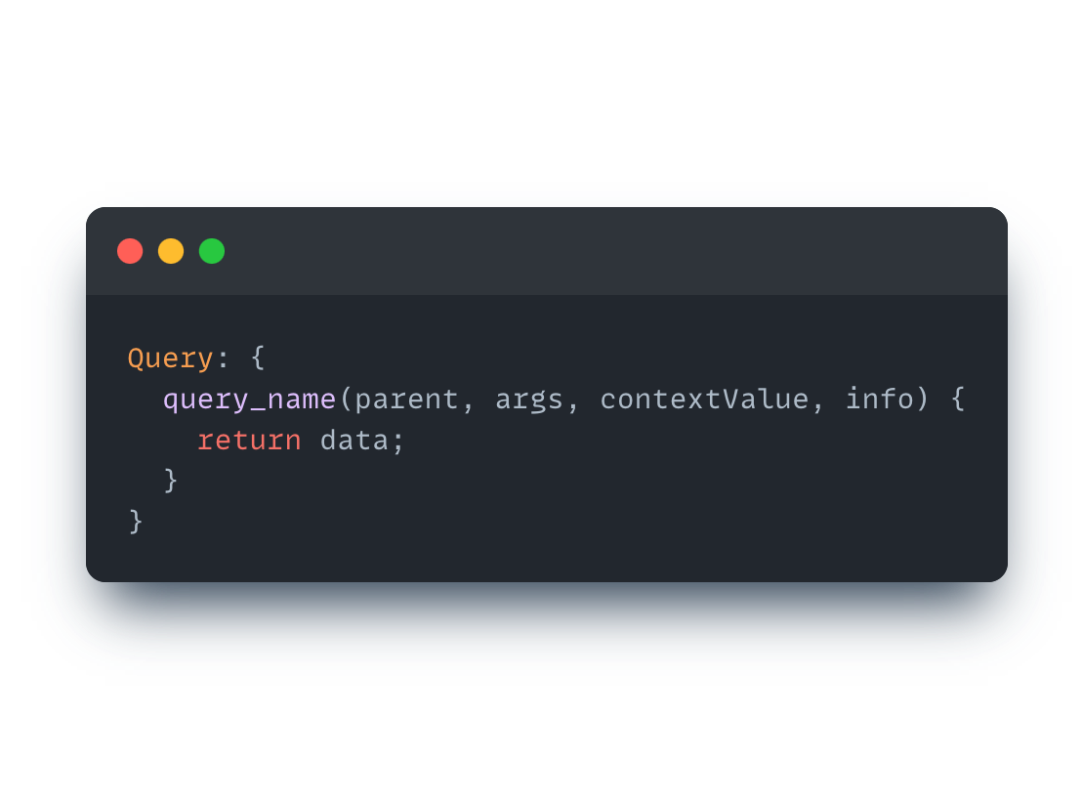
What is resolver?
A resolver is used to resolve query
How to declare a resolver?

Slide 24
What is resolver?
A resolver is used to resolve query
How to declare a resolver?
parent: The return value of the resolver for this field's parent
args: An object that contains all GraphQL arguments provided for this field.
contextValue: An object shared across all resolvers that are executing for a particular operation.
info: Contains information about the operation's execution state

Slide 25
How do resolver resolve query?
The resolver function resolves query field by field - like DFS (depth first search algorithm)

Slide 26
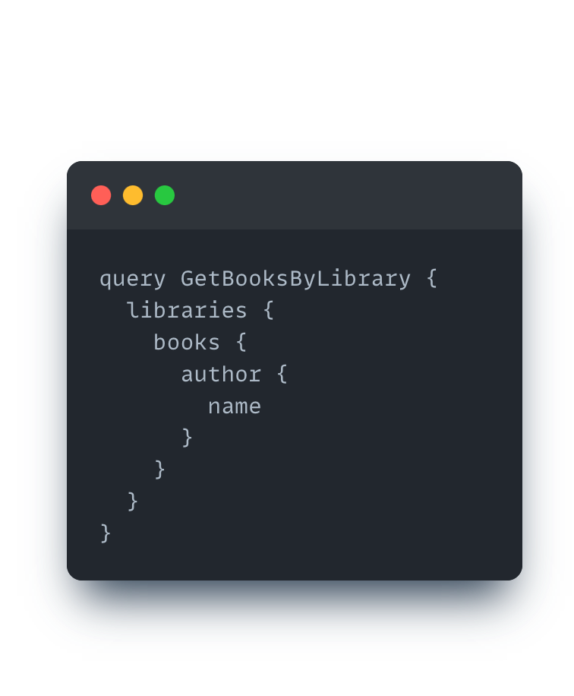
How do resolver resolve query?
The resolver function resolves query field by field - like DFS (depth first search algorithm)
Example query

Slide 27
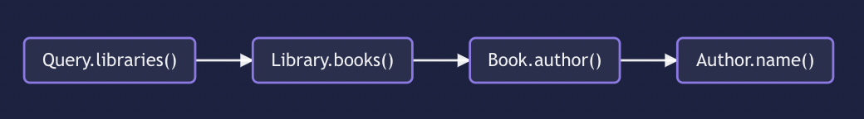
How do resolver resolve query?
The resolver function resolves query field by field - like DFS (depth first search algorithm)
Example query
Resolve chains

Slide 28
03
Mutations

Slide 29
What is mutation?
A mutation is used to mutate data

Slide 30
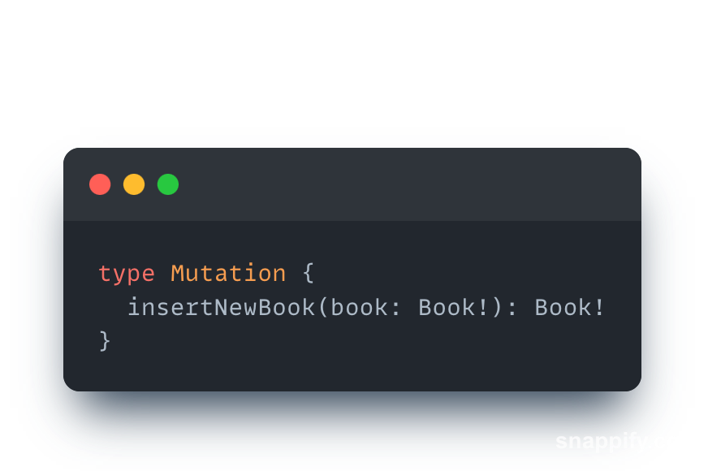
What is mutation?
A mutation is used to mutate data
How to declare a mutation?

Slide 31
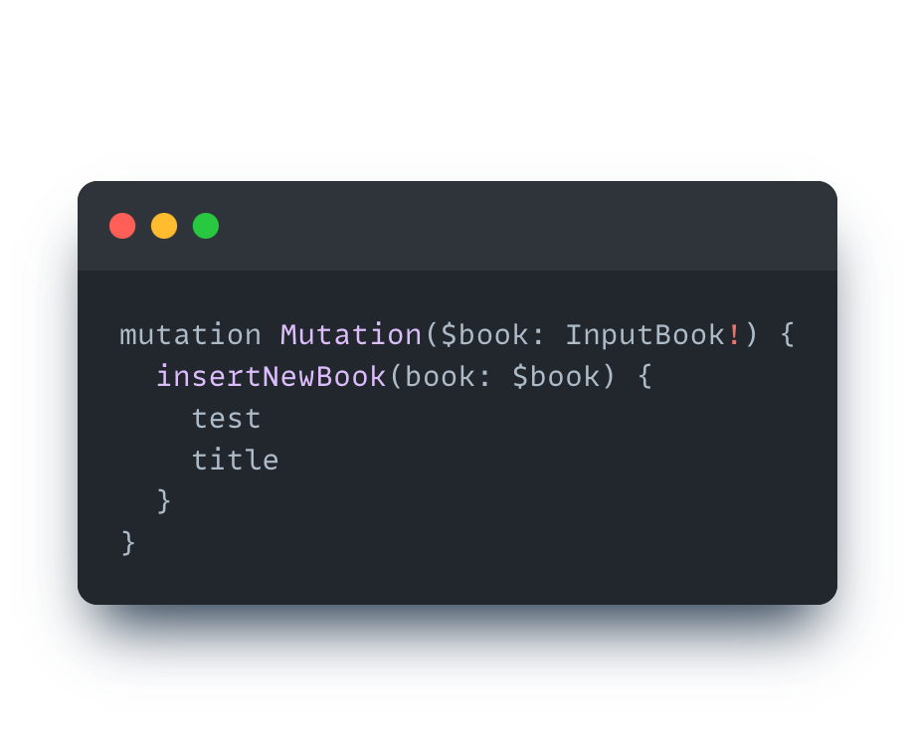
What is mutation?
A mutation is used to mutate data
How to declare a mutation?
How to use a mutation?

Slide 32
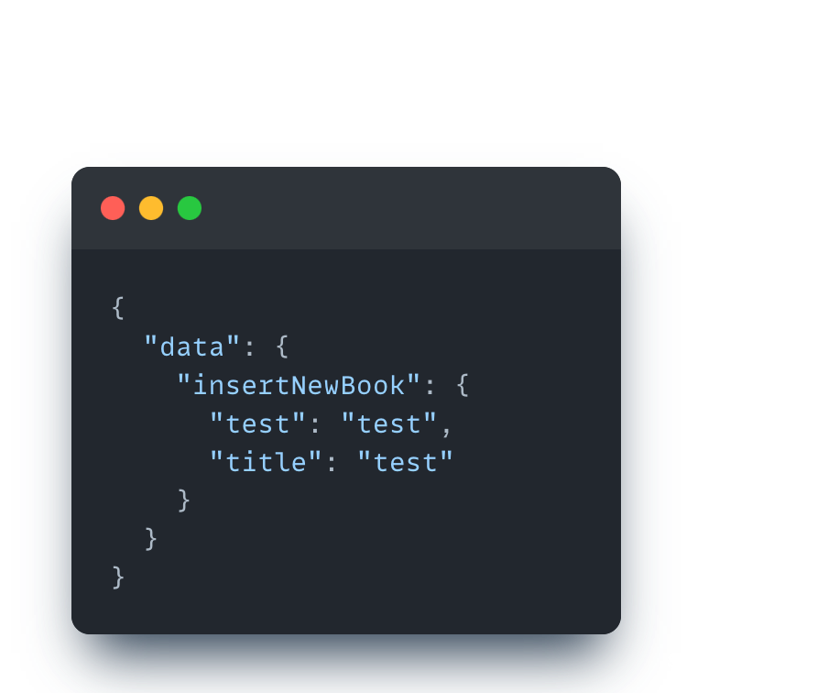
What is mutation?
A mutation is used to mutate data
How to declare a mutation?
How to use a mutation?
Example response

Slide 33
04
Subscriptions

Slide 34
What is subscriptions?
A subscriptions are a feature that allows server to send data to its client when a specific event happends

Slide 35
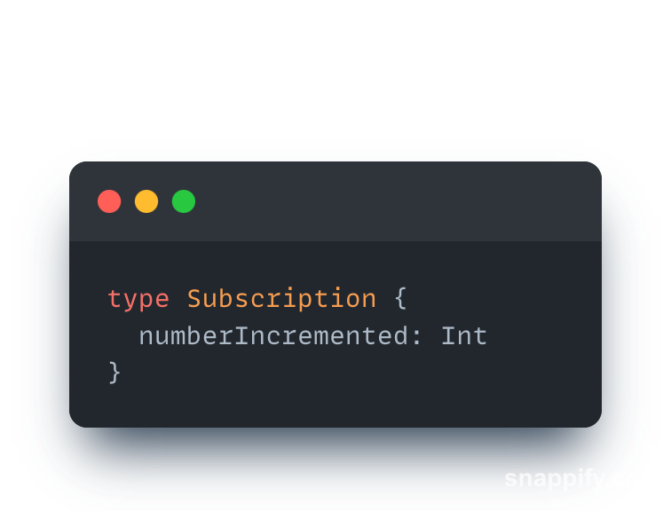
What is subscriptions?
A subscriptions are a feature that allows server to send data to its client when a specific event happends
How to declare a subscriptions?

Slide 36
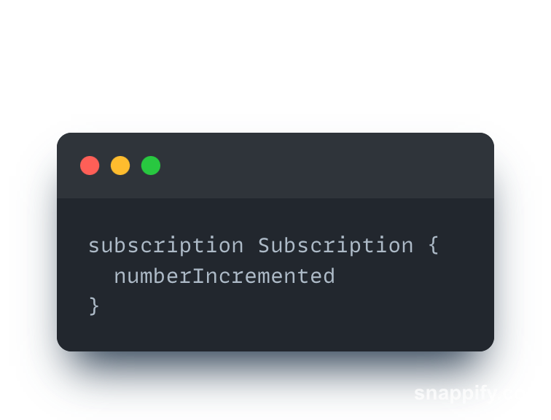
What is subscriptions?
A subscriptions are a feature that allows server to send data to its client when a specific event happends
How to declare a subscriptions?
How to use a subscriptions?

Slide 37
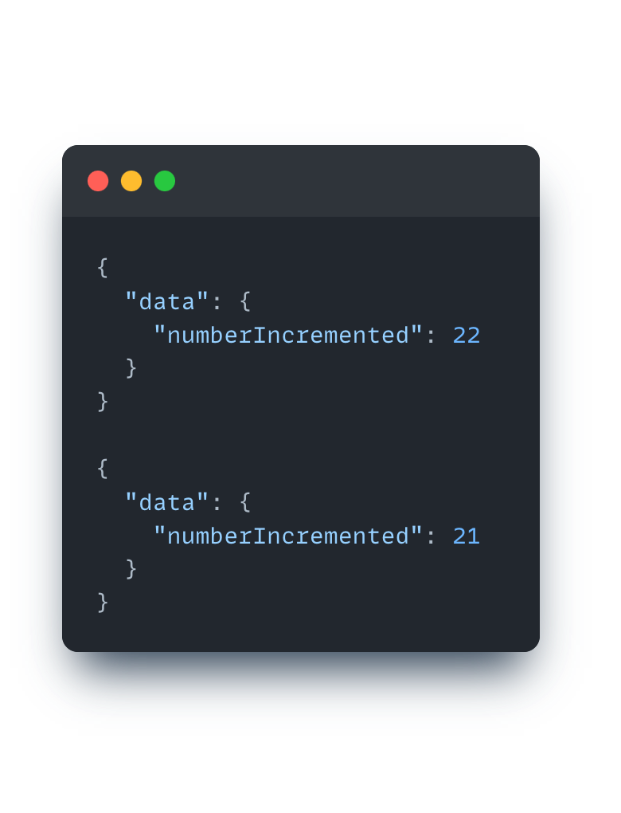
What is subscriptions?
A subscriptions are a feature that allows server to send data to its client when a specific event happends
How to declare a subscriptions?
How to use a subscriptions?
Example resposne

Slide 38
05
Errors

Slide 39
Errors
In Graphql, we don't have a standard way to return errors to the clients. Because of this reason we need to define errors for ourself

Slide 40
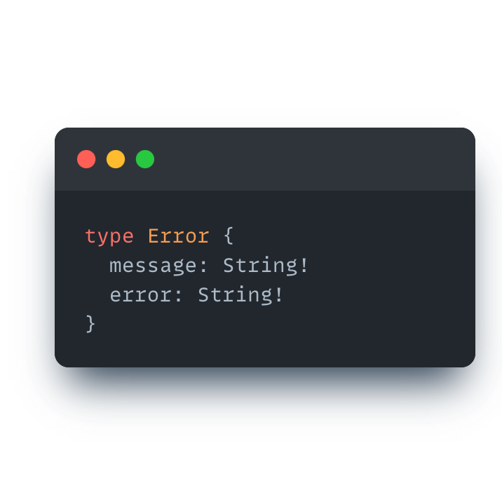
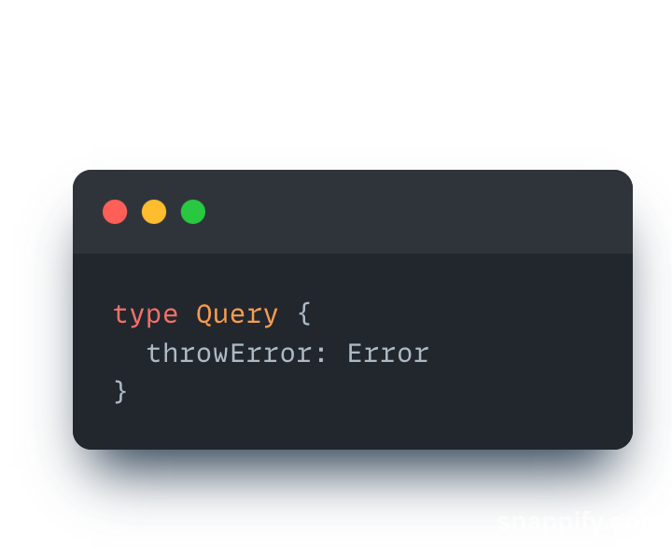
Errors
In Graphql, we don't have a standard way to return errors to the clients. Because of this reason we need to define errors for ourself
How to handle an error?

Slide 41
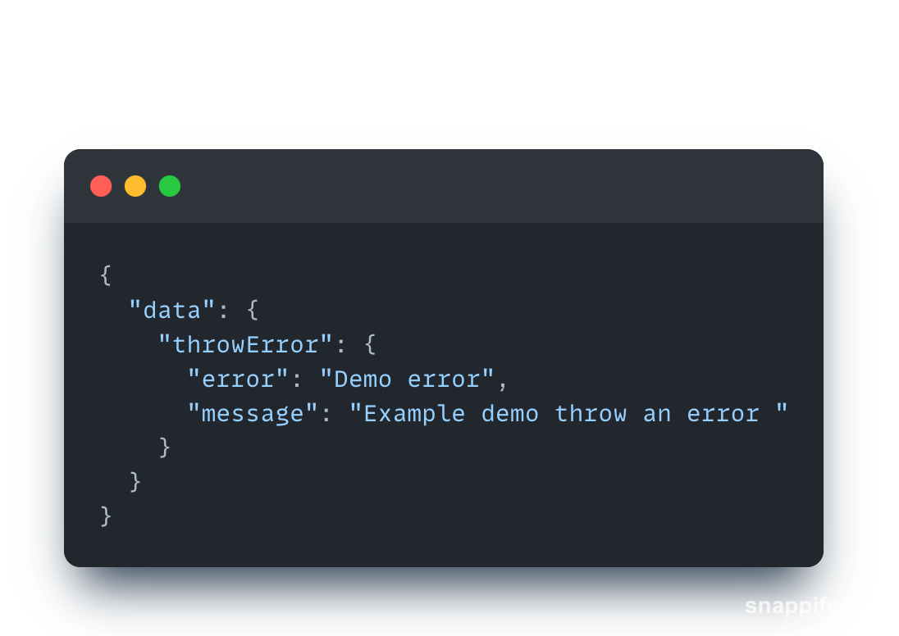
Errors
In Graphql, we don't have a standard way to return errors to the clients. Because of this reason we need to define errors for ourself
How to handle an error?
Example resposne

Slide 42
06
Typescript in Graphql

Slide 43
Code first
Code first means we don't need to write any schema code, we write Typescript code to generate schema and type files

Slide 44
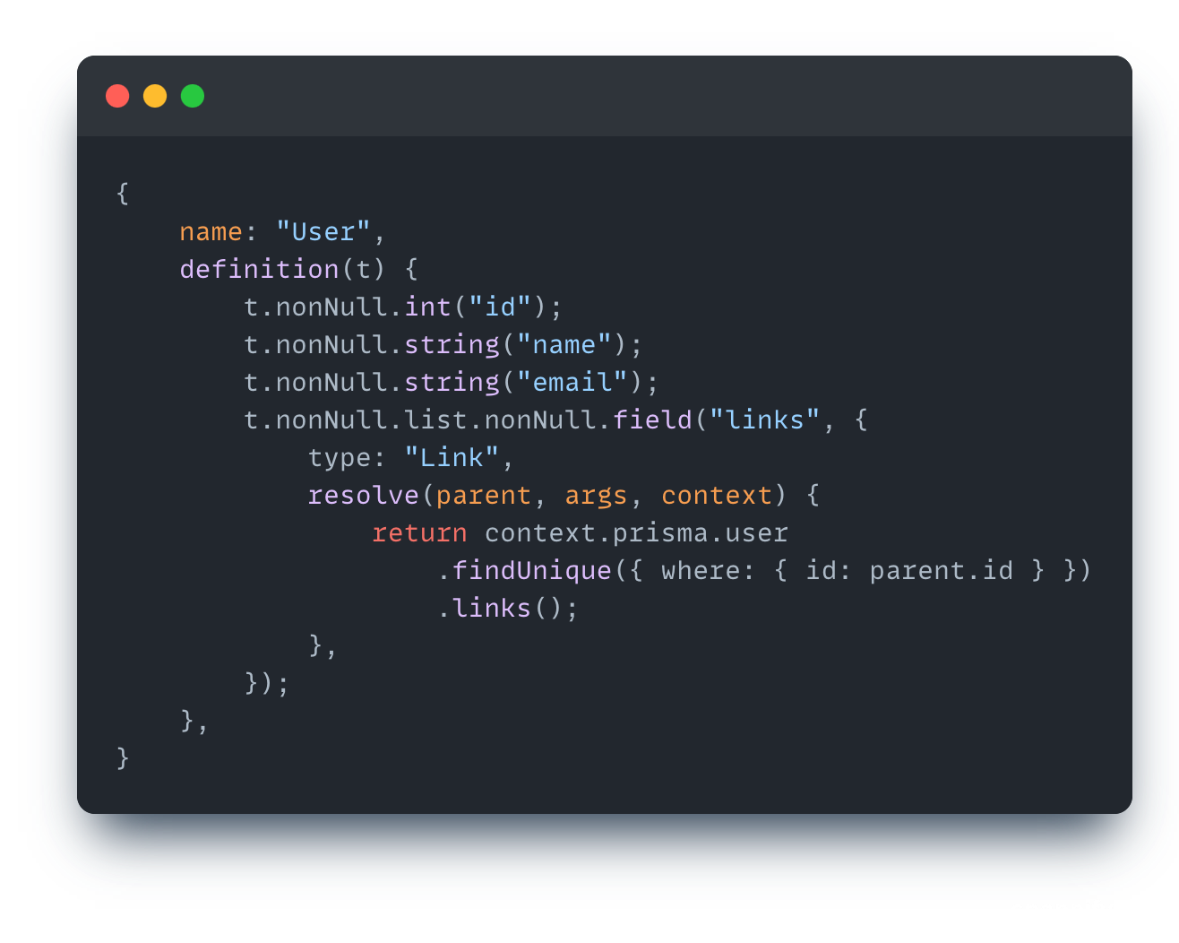
Code first
Code first means we don't need to write any schema code, we write Typescript code to generate schema and type files
Write typescript code

Slide 45
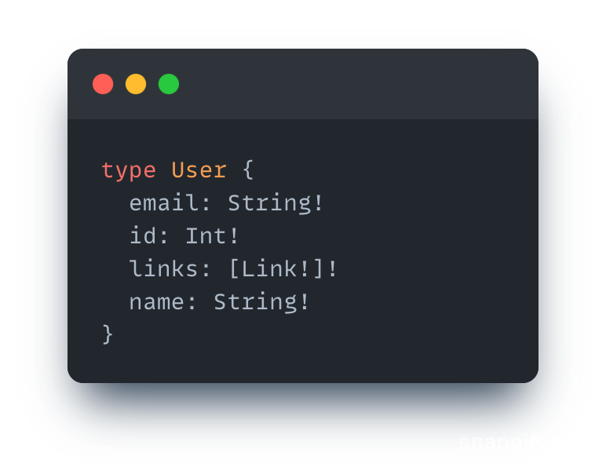
Code first
Code first means we don't need to write any schema code, we write Typescript code to generate schema and type files
Write typescript code
Generated schema

Slide 46
Code first
Advantages:
Don’t need to write schema
Don't need to write typescript that maps schema file
Can't split service and schema file
Disadvantage:
Eventually we need to work with schema file
Generate complicated typescript file, it is hard to read and reuse
There are not any solutions for federation

Slide 47
Schema first
We write schema in graphql, then using tools generate typescript mapping with schema file

Slide 48
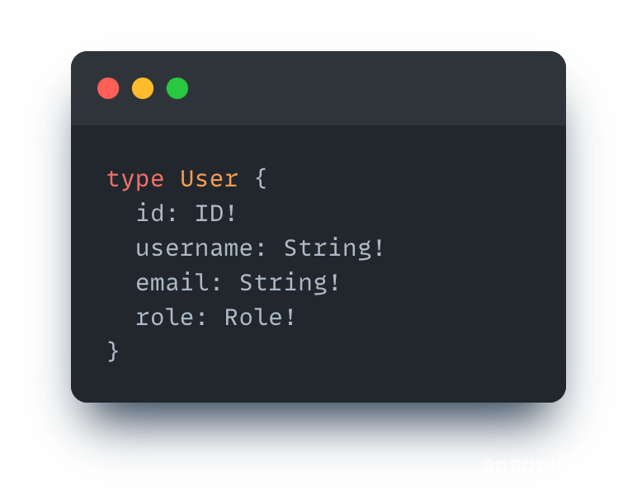
Schema first
We write schema in graphql, then using tools generate typescript mapping with schema file
Write schema

Slide 49
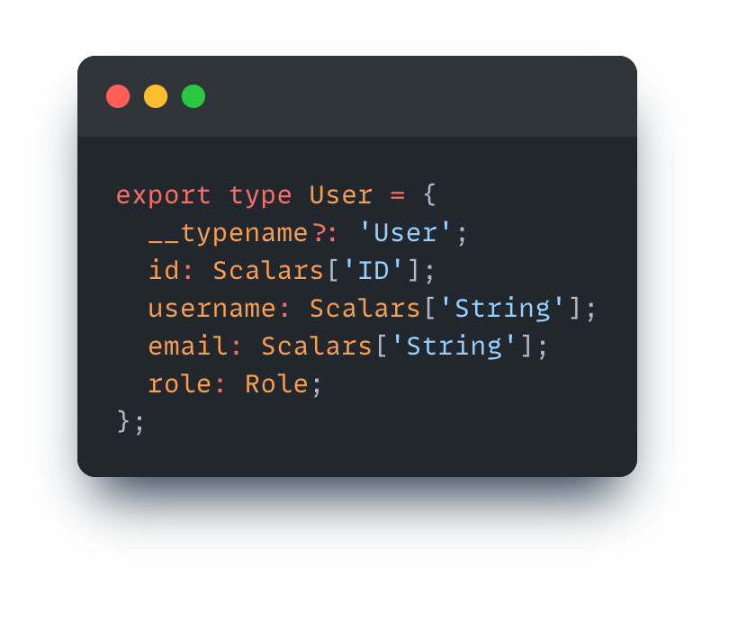
Schema first
We write schema in graphql, then using tools generate typescript mapping with schema file
Write schema
Generated typescript

Slide 50
Schema first
Advantages:
Resolve problems when we deal with code first approach
Disadvantage:
Typescript file is generated by third-party, so we can't control and take advantage of it

Slide 51
05
Pros & Cons

Slide 52
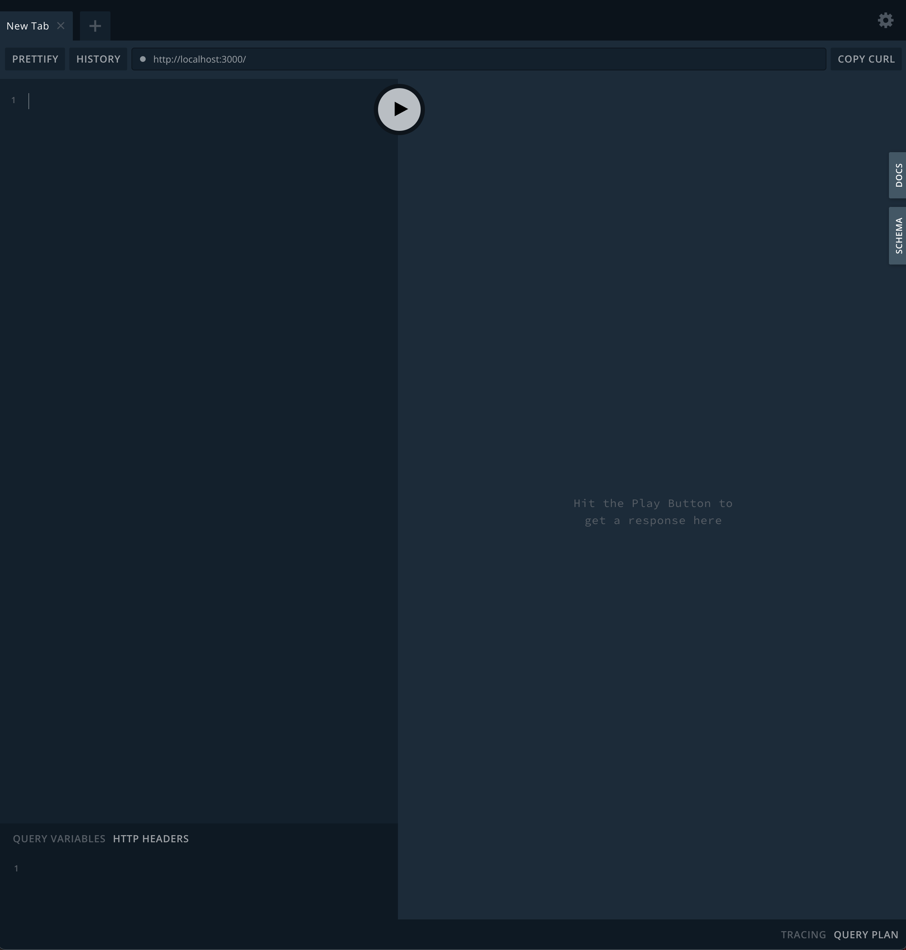
Graphql playground - Pros
We have built-in playground as documentation

Slide 53
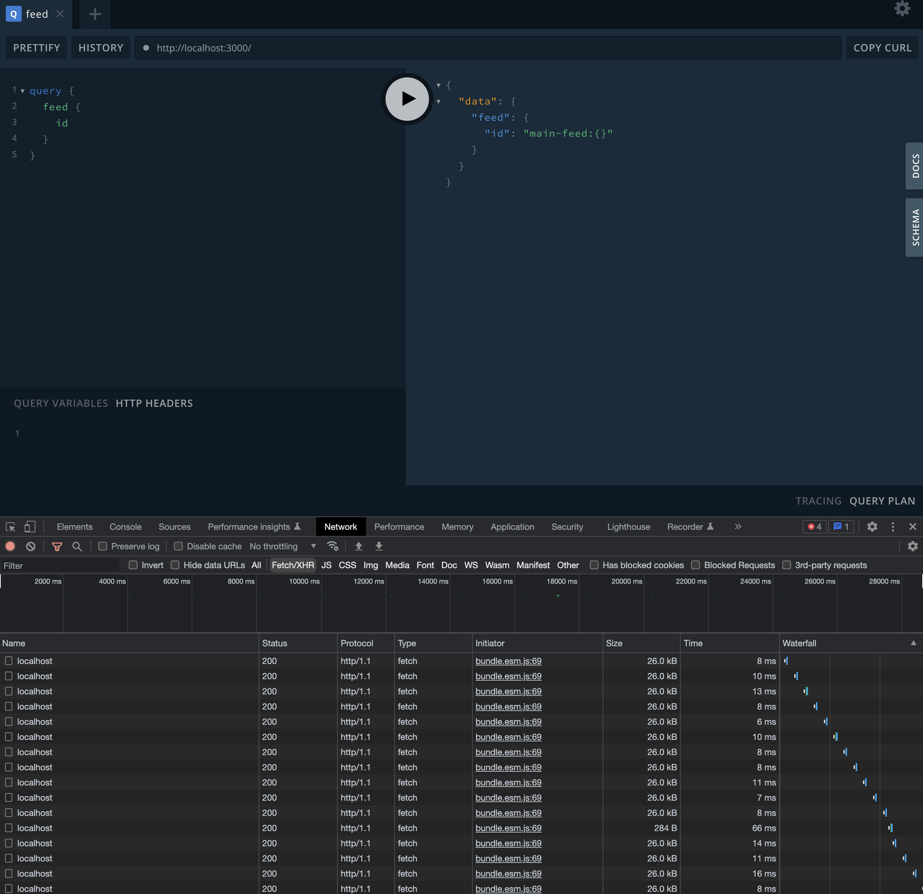
Graphql playground - Cons
Network with chrome is painful - it is hard to find what you are looking for, as all the endpoints look the same (need to inspect detail of network)

Slide 54
Version free
Nothing is free. How can we adjust for backward compatibility?
Version graphql as rest - not recommend

Slide 55
Version free
Nothing is free. How can we adjust for backward compatibility?
Version graphql as rest - not recommend
Using annotation to mark new/old fields, then monitor it

Slide 56
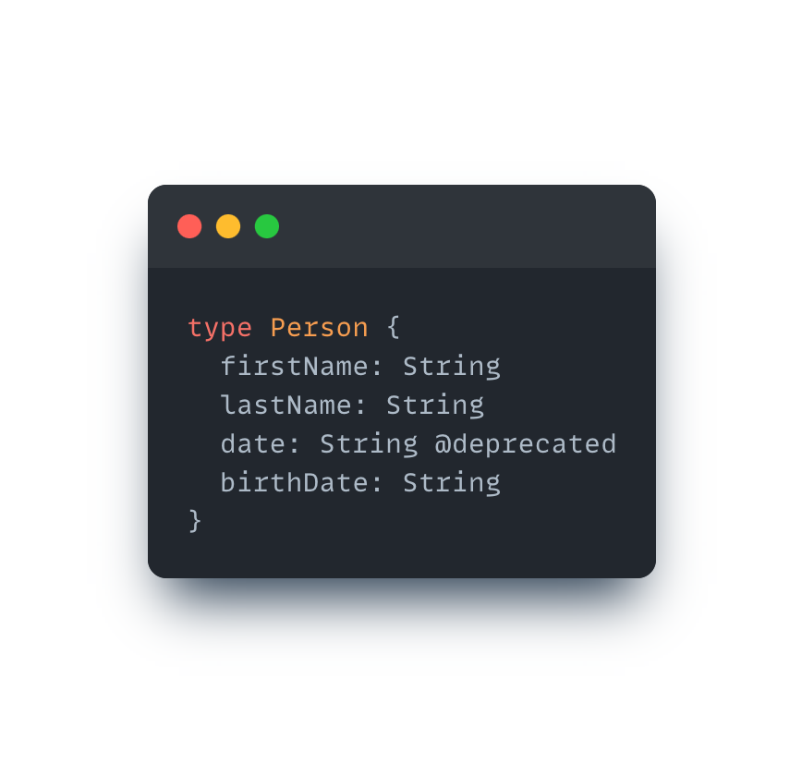
Version free
Nothing is free. How can we adjust for backward compatibility?
Version graphql as rest - not recommend
Using annotation to mark new/old fields, then monitor it

Slide 57
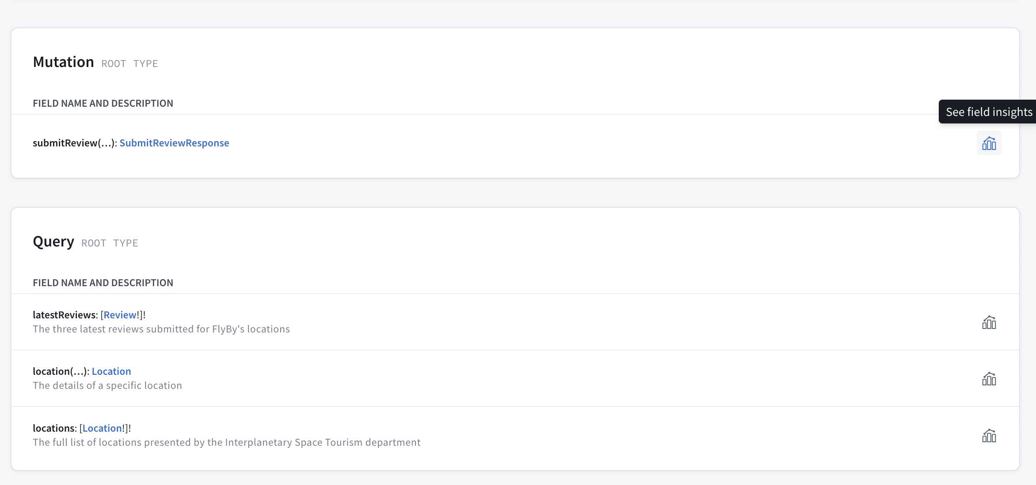
Version free
Nothing is free. How can we adjust for backward compatibility?
Version graphql as rest - not recommend
Using annotation to mark new/old fields, then monitor it

